Slide 1
Network Games Programming
Mario.Soflano@gcu.ac.uk
Room M611A
Discord: MarioSoflano#3996

Slide 2
Serialization
Serialization refers to the act of converting an object from its random access format in memory into a linear series of bits.
To transmit objects between networked instances of a multiplayer game, the game must format the data for those objects such that it can be sent by a transport layer protocol.
It explores ways to handle the issues of self-referential data, compression, and easily maintainable code, while working within the runtime performance requirements of a real-time simulation.

Slide 3
Stream
a stream refers to a data structure that encapsulates an ordered set of data elements and allows the user to either read or write data into the set.
A stream can be an output stream, input stream, or both. An output stream acts as an output sink for user data, allowing the user of the stream to insert elements sequentially, but not to read them back. In contrary, an input stream acts as a source of data, allowing the user to extract elements sequentially, but does not expose functionality for inserting them. When a stream is both an input and output stream, it exposes methods for inserting and extracting data elements, potentially concurrently.
A memory stream wraps a memory buffer. Typically, this is a buffer dynamically allocated on the heap. The output memory stream has methods for writing sequentially into the buffer, as well as an accessor that provides read access to the buffer itself.
Notes:
Often, a stream is an interface to some other data structure or computing resource. For instance, a file output stream could wrap a file that has been opened for writing, providing a simple method of sequentially storing different data types to disk. A network stream could wrap a socket, providing a wrapper for the send() and recv() functions, tailored for specific data types relevant to the user.

Slide 4
Replication
Replication is The act of transmitting an object’s state from one host to another
To successfully replicate an object, a host must take three preparatory steps before serializing the object’s internal state:
1. Mark the packet as a packet containing object state.
2. Uniquely identify the replicated object.
3. Indicate the class of the object being replicated.
Notes:
First the sending host marks the packet as one containing object state. Hosts may need to communicate in ways other than object replication, so it is not safe to assume that each incoming datagram contains object replication data.

Slide 5
Replication Feature | Description
Creation and Destruction | When an authoritative version of a replicated Actor is spawned on a server, it automatically generates remote proxies of itself on all connected clients. It will then replicate information to those remote proxies. If you destroy an authoritative Actor, it will automatically destroy its remote proxies on all connected clients.
Movement Replication | If an authoritative Actor has Replicate Movement enabled, or bReplicateMovement is set to true in C++, it will automatically replicate its Location, Rotation, and Velocity.
Variable Replication | Any variables that are designated as being replicated will automatically replicate from the authoritative actor to its remote proxies whenever their values change.
Component Replication | Actor Components replicate as part of the Actor that owns them. Any variables within the Component that are designated as being replicated will replicate, and any RPCs called within the component will behave consistently with RPCs called in the Actor class.
Remote Procedure Calls (RPCs) | RPCs are special functions that are transmitted to specific machines in a network game. No matter what machine an RPC is initially called on, its implementation will run only on the machine it is intended for. These may be designated as Server (only runs on the server), Client (only runs on the Actor's owning client), or NetMulticast (runs on every machine connected to the session, including the server).
Notes:
https://docs.unrealengine.com/4.27/en-US/InteractiveExperiences/Networking/Overview/

Slide 6
Network Process - Programming
Two basic types of networking:
networked data: objects and data primitives that you sync across a network
networked functions: are also known as remote procedure calls, or RPCs. An RPC function is effectively just an integer handle and some data that is sent once from client to server or server to client, and once the receiver gets the message, they run a function that corresponds to the integer handle using the data that was sent as parameters
Notes:
In real-time networking, you have two basic types of networking: networked data and networked functions. Networked data is objects and data primitives that you sync across a network; one example of networked data would be an object's position being simulated by the server and sent out to every client. This data is much more appropriate for unreliable streamed network data because we can typically just forget about old, lost packets and take the newest ones as ground truth.
Networked functions are also known as remote procedure calls, or RPCs. An RPC function is effectively just an integer handle and some data that is sent once from client to server or server to client, and once the receiver gets the message, they run a function that corresponds to the integer handle using the data that was sent as parameters. This is easier to keep track of in games because you can define the processing on either side of the delivery chain and you get to call it as frequently or infrequently as you want. However, you also have to be more careful about this data. Obviously if you lose the packets of an RPC call, you either need those packets to get sent again or you're losing out on whatever the other side was trying to tell you. An RPC is usually something like a "pause menu" event in a multiplayer game like Super Smash Bros. When one person pauses, the other screens also pause, but this is obviously a one-time event and not some synced variable (although it probably could be!).
https://isetta.io/blogs/week-7/

Slide 7
RPC
You must designate RPCs as being reliable or unreliable.
Unreliable RPCs are not guaranteed to arrive at their intended destination, but they can be sent faster and more frequently than reliable RPCs. They are most appropriate for functions that are either not critical to gameplay or that are called very frequently. As an example, Actor movement is replicated using an unreliable RPC due to the fact that it can change every frame.
Reliable RPCs are guaranteed to arrive at their intended destination, and will remain in a queue until they are successfully received. They are most appropriate for functions that are critical to gameplay, but that do not get called very frequently. Examples of this would include collision events, starting or ending the firing of a weapon, or spawning Actors.
Notes:
https://docs.unrealengine.com/4.27/en-US/InteractiveExperiences/Networking/Overview/

Slide 8
Remote Procedure Calls (RPCs) - Unreal
RPC Type | Description
Server | Called only on the server that is hosting the game.
Client | Called only on the client that owns the Actor that the function belongs to. If the Actor has no owning connection, this logic will not be executed.
NetMulticast | Called on all clients that are connected to the server as well as the server itself.

Slide 9
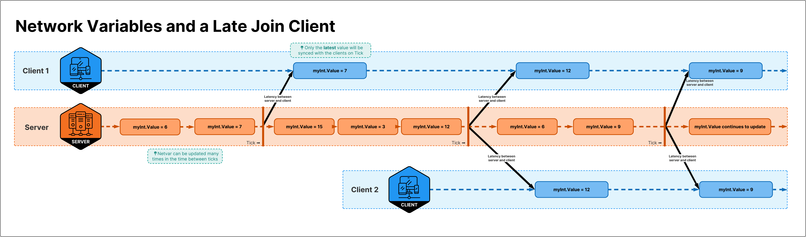
Remote Procedure Calls (RPCs) - Unity
Use RPCs for transient events, information only useful for a moment when it's received.
Use NetworkVariables for persistent states, for information that will be around more than a moment.
Notes:
Network Variables allow to seamlessly catch up late joining clients by sending the current state as soon as the tick happens.

Slide 10
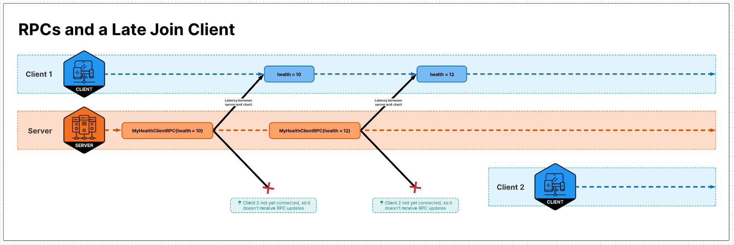
Remote Procedure Calls (RPCs) - Unity
If we sent an RPC to all clients, then all players connecting mid game after that RPC are sent will miss that information and have the wrong visual on their clients.
Sending state with RPCs will not be transmitted to late joining clients.
Notes:
https://docs-multiplayer.unity3d.com/docs/learn/rpcvnetvar

Slide 11
Challenges in Networking Games
Latency / Round Trip Time
refers to the amount of time between an observable cause and its observable effect / the time it takes for a packet to travel from one host to another, and then for a response packet to travel all the way back
Notes:
Your game, once released into the wild, must contend with a few negative factors not present in the tightly controlled environment of your local network. The first of these factors is latency. The word latency has different meanings in different situations. In the context of computer games, it refers to the amount of time between an observable cause and its observable effect. Depending on the type of game, this can be anything from the period between a mouse click and a unit responding to its orders in a real-time strategy (RTS) game, to the period between a user moving her head and a virtual reality (VR) display updating in response.
In the context of networking, engineers sometimes use the term latency to describe the combination of these four delays. Because latency is such an overloaded term though, game developers more commonly discuss round trip time, or RTT. RTT refers to the time it takes for a packet to travel from one host to another, and then for a response packet to travel all the way back. This ends up reflecting not only the two-way processing, queuing, transmission, and propagation delays, but also the frame rate of the remote host, as this contributes to how quickly it can send the response packet. Note that traffic does not necessarily travel the same speed in each direction. The RTT is rarely exactly double the time it takes for a packet to go from one host to another. Regardless, games do often approximate one-way travel time by cutting the RTT in half.
Some amount of latency is unavoidable, and different genres of games have different latency acceptability thresholds. VR games are typically the most sensitive to latency, because we as humans expect our eyes to see different things as soon as our heads swivel. In these cases, a latency of less than 20 ms is typically required for the user to remain present in the simulated reality. Fighting games, first-person shooters, and other twitchy action games are the next most sensitive to latency. Latency in these games can range from 16 to 150 ms before the user starts to feel, regardless of frame rate, that the game is sluggish and unresponsive. RTS games have the highest tolerance for latency, and this tolerance is often exploited to good effect. Latency in these games can grow as high as 500 ms without being detrimental to the user experience.
As a game engineer, decreasing latency is one manner in which you can improve your users’ play experience. To do so, it helps to understand the many factors that contribute to this latency in the first place.
RTT: The time between sending the request and receiving the answer is your ping to the game server. This means that with a ping of 20ms, it takes data 10ms to travel from the client to the server, as the ping is the round-trip time of your data.
Higher ping values mean that there is more delay or lag, which is why you want to play on servers with very low pings, as that is the basic prerequisite for games to feel snappy and responsive.

Slide 12
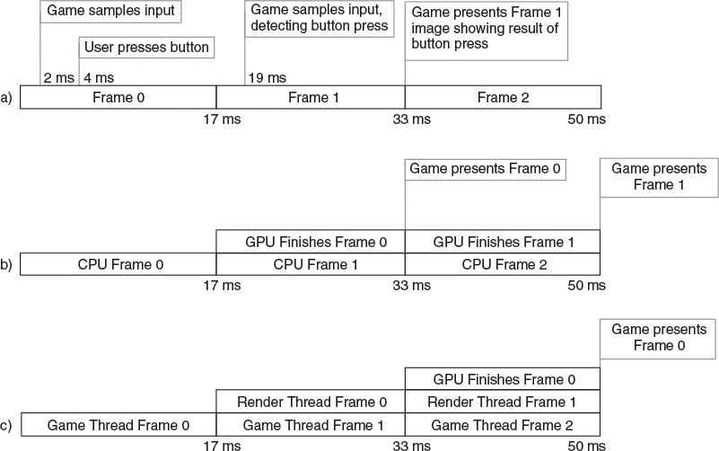
Challenges in Networking Games
Input sampling latency: The time between when a user pushes a button and when the game detects that button press
Notes:
Input sampling latency. The time between when a user pushes a button and when the game detects that button press can be significant. Consider a game running at 60 frames per second that polls a gamepad for input at the beginning of each frame, then updates all objects accordingly before finally rendering the game world. As shown in the figure, if a user presses the jump button 2 ms after the game checks for input, it will be almost an entire frame before the game updates anything based on that button press. For inputs that drive view rotation, it is possible to sample the input again at the end of a frame and mildly warp the rendered output based on altered rotation, but this is typically only done in the most latency-sensitive applications. That means that on average, there is half a frame of latency between a button press and the game’s response to that press.

Slide 13
Challenges in Networking Games - Non-network Latency
Render pipeline latency
GPUs do not perform draw commands the moment the CPU batches those commands. Instead, the driver inserts the commands into a command buffer, and the GPU executes those commands at some point in the future
Multithreaded render pipeline latency
Multithreaded games introduce even more latency into the render pipeline.
Vsync
To avoid screen tearing, it is common practice to change the image displayed by a video card only during a monitor’s vertical blanking interval. This way, the monitor will never show part of one frame and part of the next frame at the same time.
Display lag. Most HDTVs and LCD monitors process their input to some extent before actually displaying an image
Pixel response time. LCD displays have the additional problem that pixels just take time to change brightness.
Notes:
Render pipeline latency. GPUs do not perform draw commands the moment the CPU batches those commands. Instead, the driver inserts the commands into a command buffer, and the GPU executes those commands at some point in the future. If there is a lot of rendering to do, the GPU may lag an entire frame behind the CPU before it displays the rendered image to the user. The Figure shows such a timeline common in single-threaded games. This introduces another frame of latency.
Multithreaded render pipeline latency. Multithreaded games introduce even more latency into the render pipeline. Typically, one or more threads run the game simulation, updating a world that they pass to one or more render threads. These render threads then batch GPU commands while the simulation threads are already simulating the next frame. The Figure demonstrates how multithreaded rendering can add yet another frame of latency to the user experience.
VSync. To avoid screen tearing, it is common practice to change the image displayed by a video card only during a monitor’s vertical blanking interval. This way, the monitor will never show part of one frame and part of the next frame at the same time. This means that a present call on the GPU must wait until the vertical blanking interval for the user’s monitor, which is typically once every 1/60 of a second. If your game’s frames take only 16 ms, this is not a problem. However, if a frame takes even 1 ms longer to render, the rendering will not be complete by the time the video card is ready to update the display. In this case, the command to present the back buffer to the front will stall, waiting an extra 15 ms until the next vertical blanking interval. When this happens, your user experiences an extra frame of latency.
Display lag. Most HDTVs and LCD monitors process their input to some extent before actually displaying an image. This processing can include de-interlacing, HDCP as well as other DRM, and image effects like video scaling, noise cancellation, adaptive luminance, image filtering, and more. This processing comes at a cost, and can easily add tens of milliseconds to the latency users perceive. Some televisions have a “game” mode that decreases video processing to minimize latency, but you cannot count on this to be enabled.
Pixel response time. LCD displays have the additional problem that pixels just take time to change brightness. Typically this duration is in the single digits of milliseconds, but with older displays, this can easily add an extra half frame of latency. Luckily, the latency here presents more as image ghosting than absolute latency—the transition starts right away, but doesn’t complete for several milliseconds.

Slide 14
Challenges in Networking Games – Network Latency
Processing delay: The time spent examining the source address and determining an appropriate route
Transmission delay: This time spent writing the bits to physical medium
Queuing delay: A router can only process a limited number of packets at a time. If packets arrive at a rate faster than the router can process them, they go into a receive queue, waiting to be processed. Similarly, a network interface can only output one packet at a time, so after a packet is processed, if the appropriate network interface is busy, it goes into a transmission queue
Propagation delay: This time the packets spent traveling through physical medium
Notes:
You can optimize some of these delays, and some you cannot. Processing delay is typically a minor factor, as most router processors these days are very fast.
Transmission delay is usually dependent on the type of link layer connection the end user employs. Because bandwidth capability typically increases as the packet moves closer to the backbone of the Internet, it is at the edges of the Internet where transmission delay is greatest. Making sure your servers use high-bandwidth connections is most important. After that, you can best reduce transmission delay by encouraging end users to upgrade to fast Internet connections. Sending packets that are as large as possible will also help, since you reduce the amount of bytes spent on headers. If those headers are a significant portion of your packet size, they translate to a significant portion of your transmission delay.
Queuing delay is a result of packets backing up waiting to be transmitted or processed. Minimizing processing and transmission delay will help minimize queuing delay. It’s worth noting that because typical routing requires examining only the header of a packet, you can decrease the queuing delay for all your packets by sending few large packets instead of many small packets. For instance, a packet with a 1400-byte payload typically experiences as much processing delay as a packet with a 200-byte payload. If you send seven 200-byte packets, the final packet will have to sit in the queue during the processing of the six prior packets and thus will experience more cumulative network delay than a single large packet.
Propagation delay is often a very good target for optimization. Because it is based on the length of wire between hosts exchanging data, the best way to optimize it is to move the hosts closer together. In peer-to-peer games, this means prioritizing geographical locality when match making. In client-server games, this means making sure game servers are available close to your players. Be aware that sometimes physical locality isn’t enough to ensure low-propagation delay: Direct connections between locations may not exist, requiring routers to route traffic in roundabout paths instead of via a straight line. It is important to take existing and future routes into account when planning the locations of your game servers.

Slide 15

Notes:
In some cases, it is not feasible to disperse game servers throughout a geographical area, because you want all players on an entire continent to be able to play with each other. Riot games famously encountered such a situation with their title, League of Legends. Because dispersing game servers throughout the country was not an option, they took the reverse approach and built their own network infrastructure, peering with ISPs across North America to ensure they could control traffic routes and reduce network latency as much as possible. This is a significant undertaking, but if you can afford it, it is a clear and reliable way to reduce all four network delays.

Slide 16
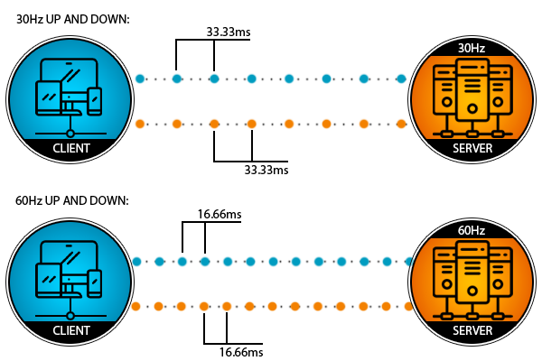
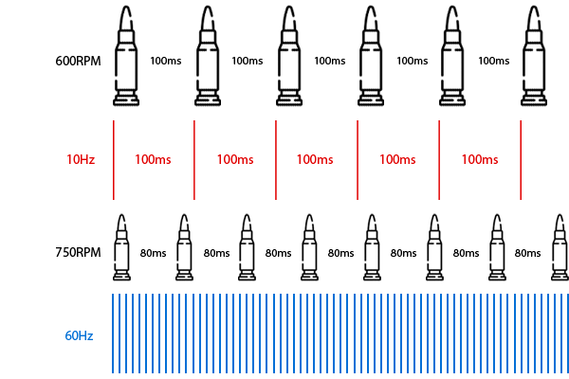
Update Rate
Notes:
What adds an extra delay on top of the travel time of our data (ping), is how frequently a game sends and receives that data. When a game sends and receives updates at 30Hz (30 updates per second), then there is more time between updates than when it sends and receives updates at 60Hz.
Low update rates do not only affect the network delay; they also cause issues like "super bullets," where a single hit from a gun deals more damage than it should be able to deal.
For example, a game server sends 10 updates per second. At this update rate we have 100ms between the updates, which is the same time that we have between two bullets when a gun fires 600 rounds per minute.
But many shooters have guns which fire 750 rounds per minute or more. As a result, we then run out of updates and so the game has to send multiple bullets with one update. If two bullets hit a player, then the damage of thesetwo hits will be sent in a single update, and so the receiving player will get the experience that he got hit by a "super bullet" that dealt more damage than a single hit should be able to deal.
RPM vs Update Rates: "Super Bullets" damage of multiple hits sent in one update:
https://docs-multiplayer.unity3d.com/docs/reference/glossary/ticks-and-update-rates

Slide 17
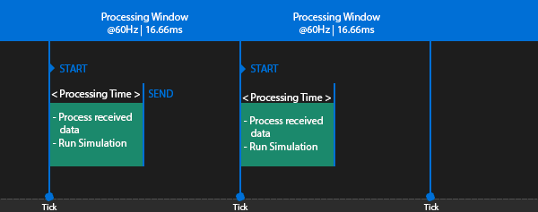
Tick or Simulation Rate
The tick rate, or simulation rate, refers to how many times per second the game produces and processes data.
Notes:
At the beginning of a tick, the server starts to process the data it received and runs its simulations. Then it sends the result to the clients and sleeps until the next tick happens. The faster the server finishes a tick the earlier the clients will receive new data from the server, which reduces the delay between player and server. That leads to a more responsive hit registration.
A tick or simulation rate of 60Hz will cause less delay than a tick rate of 30Hz, as it decreases the time between the simulation steps. A tick rate of 60Hz will also allow the server to send 60 updates per second, which compared to 30Hz reduces the round trip delay between the client and the server by about 33ms (-16ms from the client to the server, and another -16ms from the server to the client).
When a server gets close to the limit, or even fails to process a tick inside that timeframe, then you will instantly notice the results: all sorts of strange gameplay issues like rubber banding, players teleporting, hits getting rejected, and physics failing.

Slide 18
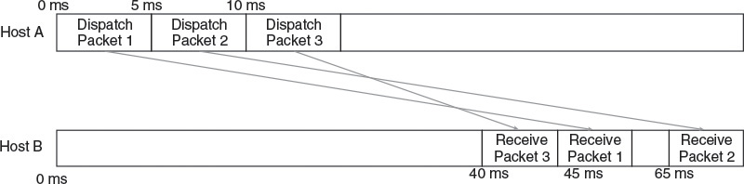
Challenges in Networking Games
Jitter is the rate at which ping changes over a period of time
Host A dispatches Packet 1, Packet 2, and Packet 3, in order, 5 ms apart, bound for a remote Host B. Packet 1 takes 45 ms to reach Host B, but due to a sudden influx of traffic on the route, Packet 2 takes 60 ms to reach Host B. Shortly after the traffic influx, the routers dynamically adjust the route causing Packet 3 to take only 30 ms to arrive at Host B. This results in Host B receiving Packet 3 first, then Packet 1, and then Packet 2. To prevent errors due to packets arriving out of order, you must either use a reliable transport protocol, like TCP, that guarantees ordered packet delivery, or implement a custom system for ordering packets
Notes:
Jitter is the rate at which ping changes over a period of time. It can affect RTT mitigation and also make packets arrive out of order if it causes the router to send packets through different routes, which can cause an older packet to arrive prior to a newer packet.
Once you have a good estimation of the RTT, you can take steps to mitigate this delay and give clients the best experience possible for their given latency. However, when writing network code, you must be mindful that the RTT is not necessarily a constant value. For any two hosts, the RTT between them does typically hover around a certain value based on the average delays involved. However, any of these delays can change over time, leading to a deviation in RTT from the expected value. This deviation is known as jitter.

Slide 19
Challenges in Networking Games
Packet Loss
Unreliable physical medium: Any external electromagnetic interference can cause corruption of this data
Unreliable link layer: Sometimes a link layer channel is completely full and an outgoing frame must be dropped
Unreliable network layer: When the queue is full, the router starts dropping either queued or incoming packets
Notes:
Unreliable physical medium. At its root, data transfer is the transfer of electromagnetic energy. Any external electromagnetic interference can cause corruption of this data. In the case of corrupted data, the link layer detects the corruption when validating checksums and discards the containing frames. Macroscale physical problems, such as a loose connection or even a nearby microwave oven, can also cause signal corruption and data loss.
Unreliable link layer. Link layers have rules about when they can and cannot send data. Sometimes a link layer channel is completely full and an outgoing frame must be dropped. Because the link layer makes no guarantee of reliability, this is a perfectly acceptable response.
Unreliable network layer. Recall that when packets arrive at a router faster than they can be processed, they are placed in a receiving queue. This queue has a fixed number of packets it can hold. When the queue is full, the router starts dropping either queued or incoming packets.
Dropped packets are a fact of life, and you must design your networking architecture to account for them. Regardless of packet loss mitigation, gameplay experience will be better with fewer dropped packets. When architecting at a high level, try to reduce the potential for packet loss. Use a data center with servers as close to your players as possible, because fewer routers and wires means a lower chance that one of them drops your data. Also, send as few packets as you can: Many routers base queue capacity on packet count, not total data. In these cases your game has a higher chance of flooding routers and overflowing queues if it sends many small packets than fewer large ones. Sending seven 200-byte packets through a clogged router requires there be seven free slots in the queue to avoid packet loss. However, sending the same 1400 bytes in a single packet only requires one free queue slot.
When its queues are full, a router does not necessarily drop each incoming packet. Instead, it may drop a previously queued packet. This happens when the router determines the incoming packet has higher priority or is more important than the queued one. Routers make priority decisions based on QoS data in the network layer header, and also sometimes on deeper information gleaned by inspecting the packet’s payload. Some routers are even configured to make greedy decisions intended to reduce the overall traffic they must handle: They sometimes drop UDP packets before TCP packets because they know dropped TCP packets will just automatically be resent. Understanding the router configurations around your data centers and around ISPs throughout your target market can help you tune your packet types and traffic patterns to reduce packet loss. Ultimately, the simplest way to reduce dropped packets is to make sure your servers are on fast, stable Internet connections and are as close to your clients as possible.

Slide 20
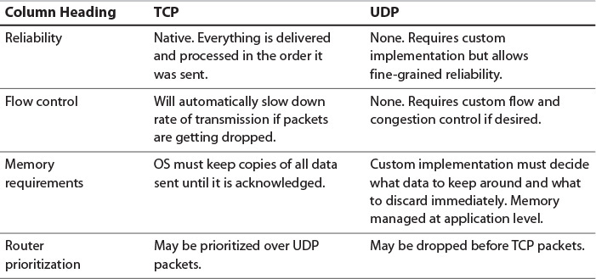

Slide 21
Solution: Relevance and Priority
Relevance is used to determine whether or not data is important and worthwhile to be replicated during the game.
Spatial Relevance
Distance from player: How many units away is this object from the networked player
Static Zones: Predefined areas of a game world, where a player typically only finds objects within their same zone or adjacent zones as relevant. Examples would be a room, building, or town.
View Frustum: If it is in the camera’s view it’s relevant. If it is behind me, it is not.
Instances: Static zones which can be instantiated/copied multiple times. Example would be a dungeon raid.
Gameplay Relevance
Interaction: Have I, or am I likely about to, interact with a gameplay element. For example, a grenade I threw far away.
Objective: Critical gameplay elements which need constant awareness. For example, a player carrying a flag across the map in CTF.
Notes:
Relevance is used to determine whether or not it is worthwhile to replicate an Actor during a multiplayer game. Actors that are not considered relevant are culled during replication. This saves bandwidth so that Actors that are relevant can replicate more efficiently. If an Actor is not owned by any players and not physically near any players, then it is not considered relevant and does not replicate. Non-relevant Actors still exist on the server and can affect the authoritative game state, but do not send information to clients until players are nearby.

Slide 22
Solution - Prioritisation
Prioritization is the process of ranking specific data in a way that balances frequent updates for objects which need to be most up-to-date, with less frequent but not starved updates for objects which can update less frequently.
Age (Staleness)
Objects or data which hasn’t been transmitted in a long time becomes higher-priority, until the next time it is transmitted, at which time its priority returns to a lower value.
Interaction
Similar to interaction as it relates to Relevancy, objects which you have recently, or are about to interact with should typically be treated as higher priority to maintain more frequent updates/synchronization.
Many things can happen to packets as they travel from origin to destination, resulting in the following problems as seen from the point of view of the sender and receiver:
Goodput
Due to varying load from disparate users sharing the same network resources, the maximum throughput that can be provided to a certain data stream may be too low for real-time multimedia services.
Notes:
https://docs-multiplayer.unity3d.com/docs/reference/glossary/prioritization

Slide 23
Solution - Prioritisation
Prioritization is the process of ranking specific data in a way that balances frequent updates for objects which need to be most up-to-date, with less frequent but not starved updates for objects which can update less frequently.
Age (Staleness)
Objects or data which hasn’t been transmitted in a long time becomes higher-priority, until the next time it is transmitted, at which time its priority returns to a lower value.
Interaction
Similar to interaction as it relates to Relevancy, objects which you have recently, or are about to interact with should typically be treated as higher priority to maintain more frequent updates/synchronization.
Many things can happen to packets as they travel from origin to destination, resulting in the following problems as seen from the point of view of the sender and receiver:
Goodput
Due to varying load from disparate users sharing the same network resources, the maximum throughput that can be provided to a certain data stream may be too low for real-time multimedia services.
Notes:
https://docs-multiplayer.unity3d.com/docs/reference/glossary/prioritization

Slide 24
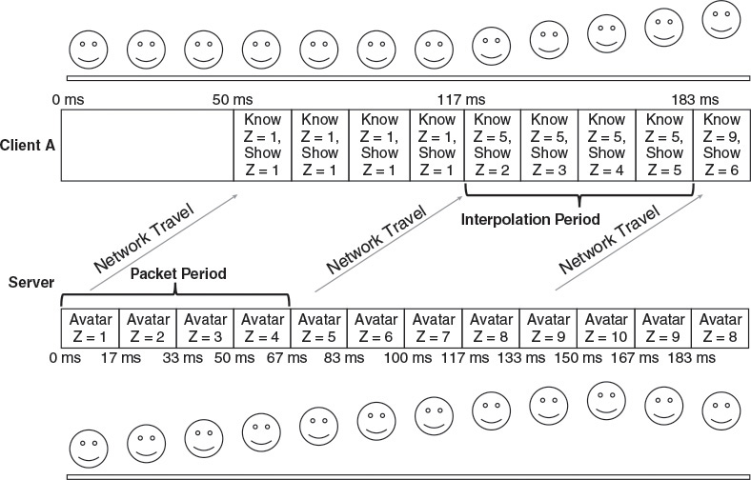
Improving Latency Handling
Client Side Interpolation
When using client side interpolation, the client game does not automatically teleport objects to their new positions sent by the server. Instead whenever the client receives new state for an object, it smoothly interpolates to that state over time using what’s known as a local perception filter
Notes:
Let IP represent the interpolation period in milliseconds, or how long the client takes to interpolate from old state to new state. Let PP represent the packet period in milliseconds, or how long the server waits between sending packets. The client finishes interpolating to a packet’s state IP milliseconds after the packet arrives. Thus if IP is less than PP, the client will stop interpolating before a new packet has arrived, and the player may still experience a stutter. To make sure that the client state is changing smoothly each frame and the interpolation never stops, IP should be no less than PP. That way, whenever the client finishes interpolating to a given state, it will have already received the next state and can begin the process again.
Remember that a dumb terminal with no interpolation is always 1/2 RTT behind the server. If state arrives but the client does not display it right away, then the player’s view of the world lags even further behind. Games using client side interpolation display state to players that is approximately 1/2 RTT + IP milliseconds behind the true state on the server. Thus, to minimize latency, IP should be as small as possible. This desire, combined with the fact IP must be greater than or equal to PP to prevent stutter, means it should be exactly equal to the PP.
The server can either notify the client how frequently it intends to send packets, or the client can compute the PP empirically by noting how rapidly packets arrive. Note that the server should set the packet period based on bandwidth, not latency. The server can send packets as frequently as it believes the network between the client and server can transmit them. This means that the latency perceived by players of games that use this type of client side interpolation is a factor of not only network latency, but also of network bandwidth.
Continuing the previous example, if the server sends 15 packets per second, the packet period is 66.7 ms. This means adding 66.7 ms of latency to 1/2 RTT that is already 50 ms. However, the game will look much smoother with interpolation than without, and it can make the experience more pleasant for the player such that latency is less of a concern.
Games that allow the player to manipulate the camera have a potential advantage here that can help reduce the feeling of extra latency. If the camera pose is not critical to the simulation, the game can handle it all client side. Walking around or shooting should require a trip to the server and back because they affect the simulation directly. Just aiming a camera might not affect the simulation in any manner, and if so, the client can update the renderer’s view transform without waiting for a response from the server. Locally handling camera interaction gives the player instant feedback when she moves the camera. This combined with the smooth interpolation can help alleviate a lot of the unpleasant feelings associated with increased latency.
Client side interpolation still is considered a conservative algorithm: Although it may sometimes represent a state that the server did not replicate exactly, it only represents states that are between two states that the server did simulate. The client smoothens out the transition from state to state, but never guesses at what the server is doing, and therefore never ends up at a wildly incorrect state. This is not true about all methodologies, as the next section shows.

Slide 25
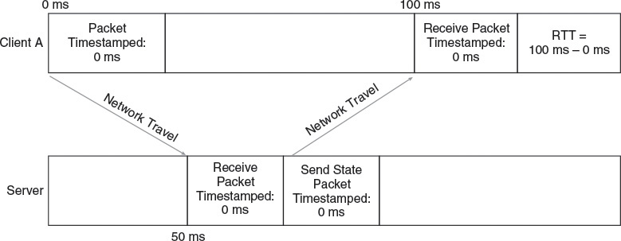
Client Side Prediction
Through extrapolation, your client can take slightly old state received by the client and bring it approximately up to date before displaying it to the player.
Notes:
Client side interpolation can smooth out your players’ gameplay experiences, but it still won’t bring them closer to what’s actually happening on the server. Even with a tiny interpolation period, state is still at least 1/2 RTT old by the time the player sees it. To show game state that is any more current, your game needs to switch from interpolation to extrapolation. Through extrapolation, your client can take slightly old state received by the client and bring it approximately up to date before displaying it to the player. Techniques that perform this sort of extrapolation are often referred to as client side prediction.
To extrapolate the current state, the client must be able to run the same simulation code that the server runs. When the client receives a state update, it knows the update is 1/2 RTT ms old. To make the state more current, the client simply runs the simulation for an extra 1/2 RTT. Then, when the client displays the result to the player, it is a much closer approximation of the true game state currently simulating on the server. To maintain this approximation, the client continues running the simulation each frame and displaying the results to the player. Eventually, the client receives the next state packet from the server and internally simulates it for 1/2 RTT ms, at which point it ideally matches the exact state that the client has already calculated based on the previous received state!
To perform extrapolation by 1/2 RTT, the client must first be able to approximate the RTT. Because the clocks on the server and client are not necessarily in sync, the naïve approach of having the server timestamp a packet and then having the client check the age of the stamp will not work. Instead, the client must calculate the entire RTT and cut it in half. The figure illustrates how to do so.
The client sends a packet to the server containing a timestamp based on the client’s own local clock. Upon receiving this packet, the server copies that timestamp into a new packet and sends it back to the client. When the client receives this new packet, it subtracts the old timestamp, based on its clock, from the current time on its clock. This yields the exact amount of time between when the client first sent the packet and when it received the response—the definition of RTT. With this information, the client knows approximately how old the rest of the data in the packet is, and can use that information to extrapolate the contained state.
Remember that 1/2 RTT is only an approximation of how old the data is. Traffic does not necessarily flow with the same speed in both directions, and thus the actual travel time from server to client may be more or less than 1/2 RTT. Regardless, 1/2 RTT is a good enough approximation for most real-time game purposes.

Slide 26
Client Side Prediction
Dead Reckoning
In a networked game, dead reckoning is the process of predicting an entity’s behavior based on the assumption that it will keep doing whatever it’s currently doing.
When a client detects that its local simulation has grown inaccurate, there are three ways it can remedy the situation:
Instant state update
Interpolation
Second-order state adjustment
Notes:
Most aspects of a game simulation are deterministic, so the client can simulate them simply by executing a copy of the server’s simulation code. Bullets fly through the air in the same way on both the server and the client. Balls bounce off walls and floors and obey the same laws of gravity. If the client has a copy of the AI code, it can even simulate AI-driven game objects to keep them in sync with the server. However, there is one class of objects that is completely nondeterministic and impossible to simulate perfectly: human players. There is no way the client can know what remote players are thinking, what actions they will initiate, or where they will move. This puts a kink in the extrapolation plan. In this scenario, the best solution is for the client to make an educated guess, and then correct this guess as necessary when an update arrives from the server.
In a networked game, dead reckoning is the process of predicting an entity’s behavior based on the assumption that it will keep doing whatever it’s currently doing. If this is a running player, it means assuming the player will keep running in the same direction. If it’s a banking plane, it means assuming it will keep banking.
When the simulated object is controlled by a player, dead reckoning requires running the same simulation that the server is running, but in the absence of changing player input. This means that in addition to replicating the pose of player-controlled objects, the server must replicate any variables used by the simulation to calculate future poses. This includes velocity, acceleration, jump state, or more, depending on the specifics of your game.
As long as remote players continue doing exactly what they’re doing, dead reckoning allows clients’ games to accurately predict the current true world state on the server. However, when remote players take unexpected actions, the client simulation diverges from the true state, and must be corrected. Given that dead reckoning makes assumptions about behavior on the server before having all the facts, dead reckoning is not considered a conservative algorithm. It is instead known as an optimistic algorithm. It hopes for the best, guesses right most of the time, but sometimes is completely wrong and must adjust
When a client detects that its local simulation has grown inaccurate, there are three ways it can remedy the situation:
Instant state update. Simply update to the new state immediately. The player may notice the object jumping around, but that might be preferable to having inaccurate data. Remember that even after the immediate update, the state from the server is still 1/2 RTT old, so the client should use dead reckoning and the latest state to simulate it another 1/2 RTT.
Interpolation. Taking a page from the client side interpolation method, your game can smoothly interpolate to the new state over a set number of frames. This could mean calculating and storing a delta to each incorrect state variable (position, rotation, etc.) that should be applied in each frame. Alternatively, you could just move the object part way to the corrected position and wait for future state from the server to continue the correction. One popular method is to use cubic spline interpolation to create a path that matches both position and velocity to transition smoothly from the predicted state to the corrected state.
Second-order state adjustment. Even interpolation may be jarring if it suddenly ramps up the velocity of a near-stationary object. To be more subtle, your game can adjust second-order parameters like acceleration to very gently ease the simulation back in sync. This can be mathematically complex, but can provide the least noticeable corrections.
Typically, games will use a combination of these methods, based on the magnitude of the divergence and on the specifics of the game. A fast-paced shooter will usually interpolate for a small error and teleport for a large. A slower-paced game like a flight simulator or giant robot mech title might use second-order state adjustment for all but the largest errors.
Dead reckoning works well for remote players, because the local player doesn’t actually know exactly what remote players are doing. When Player A watches Player B’s avatar run across the screen, the simulation diverges every time Player B changes direction, but that’s very hard for Player A to determine; without being in the same room as Player B, Player A doesn’t actually know when Player B is changing input. For the most part, she sees the simulation as consistent, even though the client application is always guessing at least 1/2 RTT ahead of whatever the server has told it.

Slide 27
Client Side Prediction
Client Move Prediction and Replay
Player A enters all her input directly into Client A, so the game on Client A can just use that input to simulate her avatar. As soon as Player A pushes a button to run forward, the client can start simulating her run. When the input packet reaches the server, it can begin the simulation as well, updating Player A’s state accordingly.
Hiding Latency through Tricks and Optimism
Notes:
Client Move Prediction and Replay
Dead reckoning cannot hide latency for a local player. Consider the case of Player A, on Client A, starting to run forward. Dead reckoning uses state sent by the server to simulate, so from the time she pushes forward, it takes 1/2 RTT for the input to get to server, at which point the server adjusts her velocity. Then it takes 1/2 RTT for the velocity to get back to Client A, at which point the game can use dead reckoning. There’s still a lag of RTT between when a player presses a button and when that player sees results.
There is a better alternative. Player A enters all her input directly into Client A, so the game on Client A can just use that input to simulate her avatar. As soon as Player A pushes a button to run forward, the client can start simulating her run. When the input packet reaches the server, it can begin the simulation as well, updating Player A’s state accordingly. Not everything is so simple though.
A problem arises when the server sends a packet back to Client A containing Player A’s replication state. Remember that when using client side prediction, all incoming state should be simulated an additional 1/2 RTT to catch up to the true state of the world. When simulating remote players, the client can just use dead reckoning and update assuming no change in input. Typically the updated incoming state will match the exact state the client has already predicted—if it doesn’t, the client can smoothly interpolate the remote player into place. This won’t work for local players. Local players know exactly where they are and will notice interpolation. They should not experience drifting or smoothing whenever they change their input. Ideally, moving around should feel to a local player like she is playing a single player, non-networked game.
One possible solution to this problem is to completely ignore the server’s state for the local player. Client A can derive Player A’s state solely from its local simulation, and Player A will have a smooth movement experience, with no latency. Unfortunately, this can cause Player A’s state to diverge from the server’s true state. If Player B bumps into Player A, there is no way for Client A to accurately predict the server’s resolution of the collision. Only the server knows Player B’s true position. Client A has a dead reckoned approximation of Player B’s position, so cannot resolve the collision in exactly the same way the server would. Player A might end up in a pit of fire on the server, yet free and clear on the client, which can lead to much confusion. Because Client A ignores all incoming Player A state, there would be no way for the client and server to ever sync up again.
Luckily, there is a better solution. When Client A receives Player A’s state from the server, Client A can use Player A’s inputs to resimulate any state changes Player A instigated since the server calculated the incoming state. Instead of simulating the 1/2 RTT using dead reckoning, the client can simulate the 1/2 RTT using the exact input Player A used when the client side simulation originally ran. By introducing the concept of a move, input state tied to a timestamp, the client can keep track of what Player A was doing at all times. Whenever incoming state arrives for a local player, the client can figure out which moves the server did not yet receive when calculating that state, and then apply those moves locally. Unless there was an encounter with an unexpected, remote player initiated event, this should end up with the same state the client had already locally predicted.
Hiding Latency through Tricks and Optimism
Delayed movement is not the only indication of latency to a player. When a player presses the button to shoot a gun, she expects her gun to fire immediately. When she tries to cast an attack spell, she expects her avatar to throw a big ball of fire. Move replay does not handle a situation like this, so something else is necessary. It’s usually too complicated for the client to create projectiles in a way that the server can take over replicating their state once it creates them itself—there is a simpler solution.
Almost all video game actions have tells, or visual cues that indicate something is happening. Muzzle flashes precede plasma blasts, and mages wave their hands and mumble before spraying fire. These tells usually last at least as long as a round trip to the server and back. This means that, optimistically, the client application can give a local player instant feedback to any input by playing the appropriate animation and effects locally, while waiting for the true simulation to be updated on the server. This doesn’t mean that the client spawns projectiles, but it does start playing the spell casting animation and sound. If all is well, during the spell casting, the server receives the input packet, spawns the fire ball, and replicates it to the client, in time to show up as a result of the spell casting. Dead reckoning code advances the projectile forward by 1/2 RTT and it looks to the player as if she threw a fireball with no latency. If there is a problem, for instance, if the server knows that the player was recently silenced but hasn’t yet replicated that to the player, the optimism proves unwarranted and the spell casting animation fires without a projectile appearing. This is a rare case though, and well worth the benefit typically provided.

Slide 28
Improving Latency Handling
Server Side Rewind
Made popular by Valve’s Source Engine, and responsible for the accuracy players feel when firing weapons in games like Counter-Strike. At its core, it works by rewinding state on the server to exactly the state the player perceived when lining up a shot and firing.
To accomplish this feat, the game must make a few adjustments to the client side prediction methods discussed earlier:
Use client side interpolation without dead reckoning for remote players
Use local client move prediction and move replay
Record the client’s view in each move packet sent to the server
On the server, store the poses of every relevant object for the last several frames
Notes:
Server Side Rewind
Using these various client side prediction techniques, your game can provide a fairly responsive experience to players, even in the presence of moderate latency. However, there is still one common type of game action which client side prediction does not handle perfectly: the long range, instant-hit weapon. When a player equips a sniper rifle, perfectly positions the reticle over another player, and pulls the trigger, she expects a perfect hit. However, due to the inaccuracies of dead reckoning, it is possible that a perfectly lined up shot on the client is not a perfectly lined up shot on the server. This can be a problem for games that rely on realistic, instant-hit weapons.
There is a solution to this, made popular by Valve’s Source Engine, and responsible for the accuracy players feel when firing weapons in games like Counter-Strike. At its core, it works by rewinding state on the server to exactly the state the player perceived when lining up a shot and firing. That way, if the player perceived that she aimed perfectly, her shot will hit 100% of the time.
To accomplish this feat, the game must make a few adjustments to the client side prediction methods discussed earlier:
Use client side interpolation without dead reckoning for remote players. The server needs to have accurate knowledge of exactly what client players see at any time. Because dead reckoning relies on the client advancing the simulation based on its assumptions, it would cause extra complexity for the server, and thus should be turned off. To prevent any jerkiness or stuttering between packets, the client instead uses client side interpolation as described earlier in this chapter. The interpolation period should be exactly equal to the packet period, which is tightly controlled by the server. Client side interpolation introduces additional latency, but it turns out this is not significantly noticed by the player because of move replay and the server side rewind algorithm.
Use local client move prediction and move replay. Although client side prediction is disabled for remote players, it must remain on for the local player. Without local move prediction and move replay, the local player would instantly notice both the latency from network traffic and the increased latency from the client side interpolation. However, by simulating player moves immediately, the local player never feels lagged, regardless of how much latency there is.
Record the client’s view in each move packet sent to the server. The client should stamp every input packet sent with the IDs of the frames between which the client is currently interpolating, and the percentage of the interpolation that is complete. This gives the server an exact indication of the client’s perception of the world at the time.
On the server, store the poses of every relevant object for the last several frames. When a client input packet comes in containing a shot, look up the two stored frames between which the client was interpolating at the time of the shot. Use the interpolation percentage in the packet to rewind all relevant objects to exactly where they were when the client pulled the trigger. Then perform a ray cast from the client’s position to determine if the shot landed.
Server side rewind guarantees that if the client player lined up a shot correctly, it will land on the server. This gives a very satisfying feeling to the shooting player. However, it does not come without drawbacks. Because it rewinds server time by an amount based on the latency between server and client, it can end up causing some unexpected and frustrating experiences for the victims of the shots. Player A may think she has safely ducked around a corner, taking refuge from Player B. However, if Player B is on a particularly laggy network connection, he might have a view of the world that is 300 ms behind that of Player A. Thus on his computer, Player A may not have ducked behind the corner yet. If he lines up the shot and fires, the server will credit a hit to him and alert Player A that she was shot, even though she believed she was safely around a corner. As for all things in game development, it is a tradeoff. Only use these techniques if it is appropriate based on the specifics of your game.

Slide 29
Rule of Thumb – Latency and Jitter
Send as few packets as possible to keep traffic low.
Locate servers near players to reduce the chance of encountering heavy traffic.
Keep in mind that frame rate also affects RTT, so wild variations in frame rate will negatively impact clients.
Make sure that complex operations are appropriately aggregated across multiple frames to prevent frame rate induced jitter.

Slide 30
References
https://docs-multiplayer.unity3d.com/docs/learn/lagandpacketloss
https://docs-multiplayer.unity3d.com/docs/learn/clientside_interpolation
https://docs-multiplayer.unity3d.com/docs/reference/glossary/prioritization
https://docs-multiplayer.unity3d.com/docs/reference/glossary/relevancy
https://docs.unrealengine.com/4.27/en-US/InteractiveExperiences/Networking/Overview/

Slide 31
References - Others
Papers
https://link-springer-com.gcu.idm.oclc.org/content/pdf/10.1007/s11042-015-3001-y.pdf

